Slide 1
Bayesian inference
]
Use Case: Phone number scanner App
Aldo Narvaez Cao Romero

Slide 2
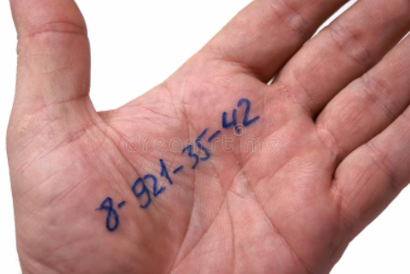
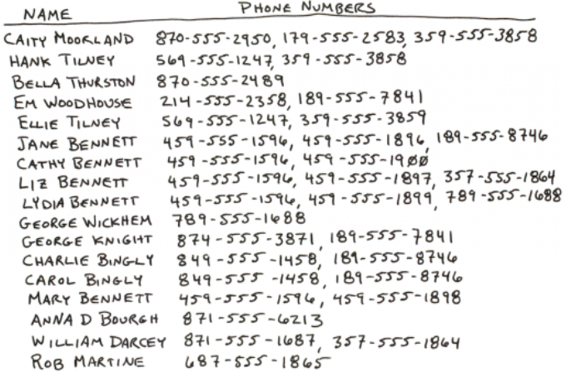
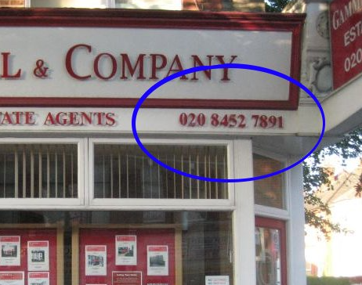
Why a phone number scanner?

Slide 3
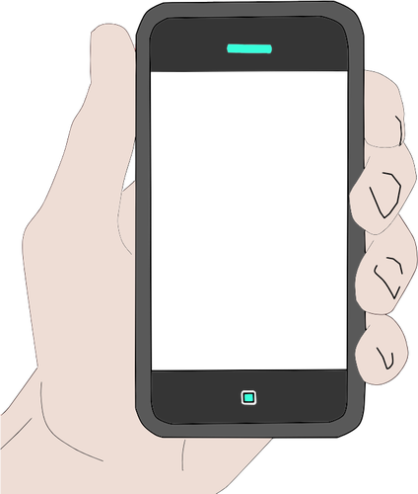
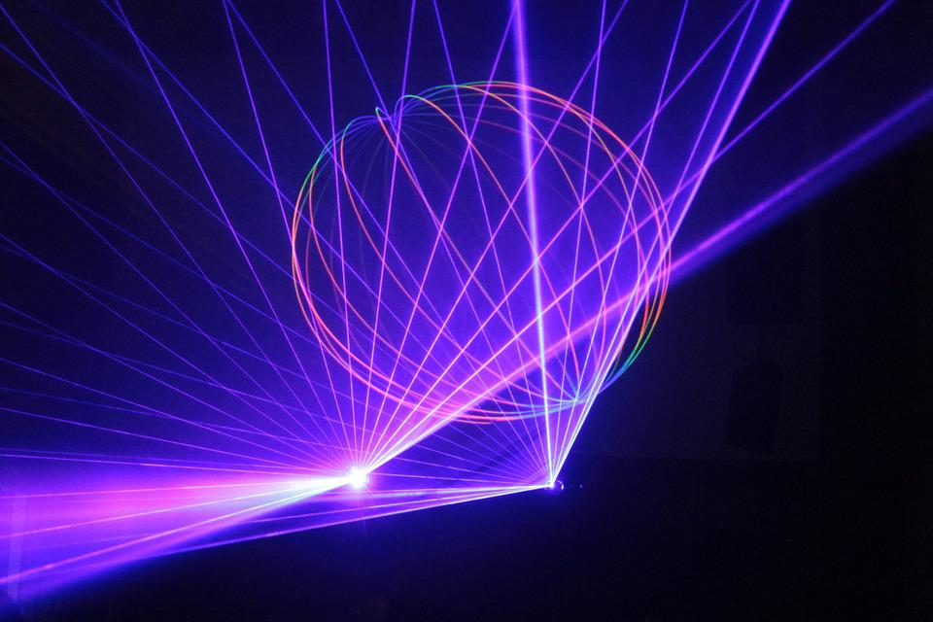
PHONSCANN
Phone Number
Account number
Phone Number
Wi-Fi password
Advertisement space

Slide 4
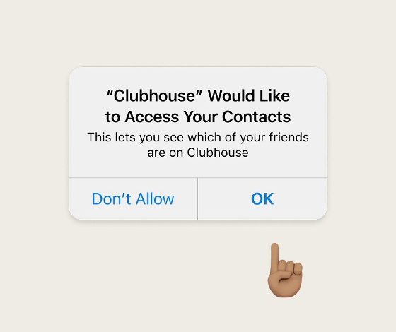
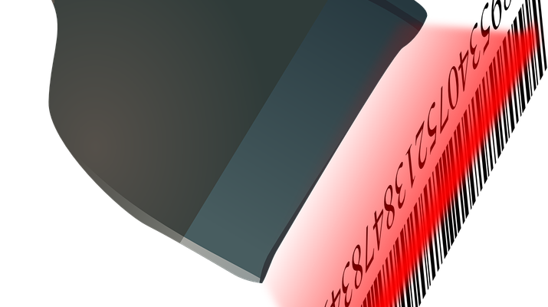
PhoneScann
Phone Number
123-456-7890
Add
Save
Delete

Slide 5
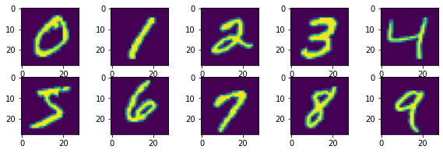
How does it work?
It was used the Gaussian Bayes algorithm as a cornerstone in the App.
We take a collection of encoded handwritten numbers to use them has a database.

Slide 6
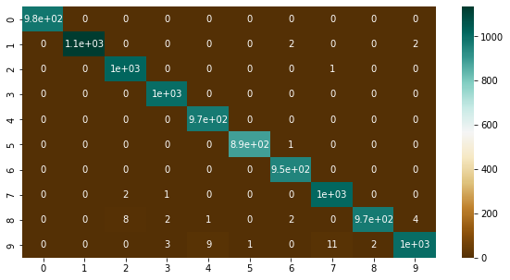
Effectiveness
It was found a 99% of accuracy in the model.

Slide 7


What happen with 9?
A 9 was predicted when, actually, it was a 7…
…or a 4

Slide 8
Why people would use our App?
Why you should invest in our project?
Its practicality.
Its fast uploading due to its simplicity.
Comfortable and useful advertisements
Its low cost due to simplicity.
Is is expected a great amount of income from the advertisements.
An idea based on an innovative technology.

Slide 9
Final remarks
It was presented a new App to recognize handwritten phone numbers with an easy user interface
We apply the Gaussian-Bayes algorithm and it was found an accuracy of 99% to recognize numbers
It was presented a confusion matrix to analyse the values that went wrong during the prediction.
There were given some arguments to proof how this app can be useful and why you should invest on it.

Slide 10
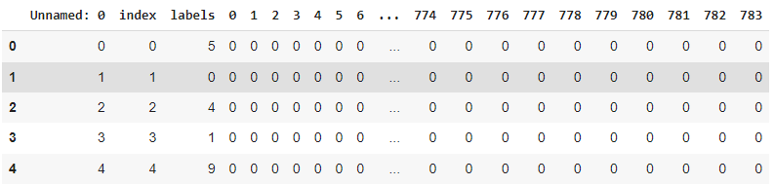
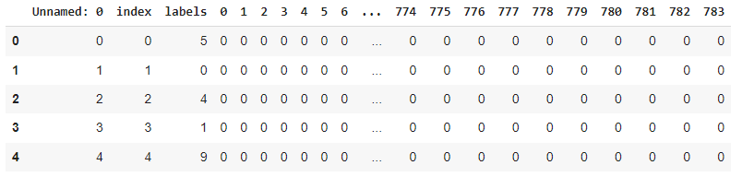
Appendix
Training and Test data respectively

Slide 11
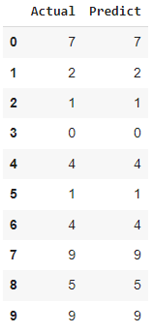
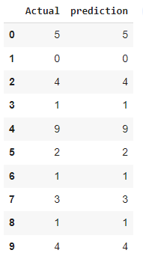
Predictions
Test Data
Training Data

Slide 12
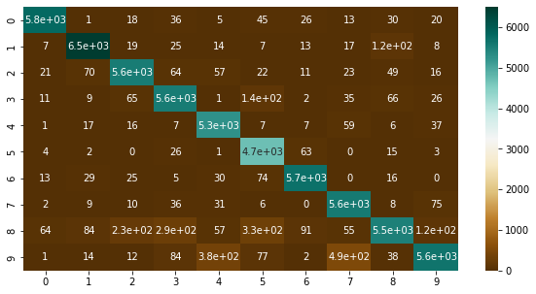
Confusion matrix for the Training data

